Slide 1
Data Warehousing and Mining
Module 2:Data Preprocessing
Faculty Name: Ms.Puja Vakhare

Slide 2
Index -
Lecture 8 - Measuring similarity and dissimilarity. | 3
Lecture 9 - Data Pre-processing | 24
Lecture 10 - Histograms, Clustering and Sampling, Data Transformation | 52
Lecture 11-Normalization, Binning, Histogram analysis and concept hierarchy generation | 63

Slide 3
Lecture 8
Measuring Similarity and Dissimilarity

Slide 4
Similarity and Dissimilarity
Similarity
  Numerical measure of how alike two data objects are
  Value is higher when objects are more alike
  Often falls in the range [0,1]
Dissimilarity (e.g., distance)
  Numerical measure of how different two data objects are
  Lower when objects are more alike
  Minimum dissimilarity is often 0
  Upper limit varies
Proximity refers to a similarity or dissimilarity
Lecture 8-Measuring similarity and dissimilarity

Slide 5


Data Matrix and Dissimilarity Matrix
Data matrix
  n data points with p dimensions
  Two modes
Dissimilarity matrix
  n data points, but registers only the distance
  A triangular matrix
  Single mode
Lecture 8-Measuring similarity and dissimilarity

Slide 6
Distance Measure( Jaccard Distance)
  The Jaccard similarity of two sets is the size of their intersection divided by the size of their union:
  sim(C₁, C₂) = |C₁∩C₂|/|C₁∪C₂
  Jaccard distance: d(C₁, C₂) = 1 - |C₁∩C₂|/|C₁∪C₂|
Verify the function:
d(x,y) is nonnegative: becoz size of intersection cannot exceed the size of union.
d(x,y)=0 is strictly positive.
d(x,y)=d(y,x) : both union and intersections are symmetric.
For triangle inequality SIM(x,y)is the probability a random minhash function maps x and y to the same value.
Lecture 8-Measuring similarity and dissimilarity

Slide 7
Distance Measure( Euclidian Distance)
N dimensional space is one where points are vectors of n real numbers.
It verify first three points:
Distance between two points cannot be negative
Aii squares of real numbers are nonnegative (xi!yi)
If xi=yi then the distance is clearly zero
The sum of the lengths of any two sides of a triangles is no less than the length of the third side.
Lecture 8-Measuring similarity and dissimilarity

Slide 8
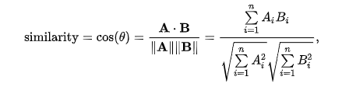
Distance Measure( Cosine Distance)
The cosine distance makes sense in space(dimension)
Where points are vectors with integer components or Boolean components.
Cosine distance between two points is the angle that the vectors to those points make.
The angle can be in range 0 to 180 degrees.
Calculate the cosine distance first compute the cosine of angles.
Then applying the arc-cosine function to translate to an angle in the 0 – 180 degree range.
Lecture 8-Measuring similarity and dissimilarity

Slide 9
Distance Measure( Edit Distance)
The distance makes sence when points are strings.
The distance between two strings x=x1x2---------xn and y=y1y2----------ym
The smallest number of insertion and deletion of single characters that will convert x to y.
Edit distance can be negative only two identical strings have an edit distance of 0
Edit distance is symmetric: when th sequence of insertion and deletion can be reversed.
The triangle inequality is also straightforward.
D(x,y)=|x|+|y|-2|LCS(x,y)|
Lecture 8-Measuring similarity and dissimilarity

Slide 10
Distance Measure( Hamming Distance)
Hamming distance cannot be negative
If it is zero, vectors are identical
The distance does not depends upon which two vector we consider first.
The triangle inequality should also evident
If x and z differ in m components and z and y differ in n components , then x and y cannot differ in more than m+n components.
Hamming distance is used when the vectors are Boolean; they consist values of 0’s and 1’s.
Lecture 8-Measuring similarity and dissimilarity

Slide 11

Proximity Measure for Nominal Attributes
Can take 2 or more states, e.g., red, yellow, blue, green (generalization of a binary attribute)
Method 1: Simple matching
  m: # of matches, p: total # of variables
Method 2: Use a large number of binary attributes
  creating a new binary attribute for each of the M nominal states
Lecture 8-Measuring similarity and dissimilarity

Slide 12
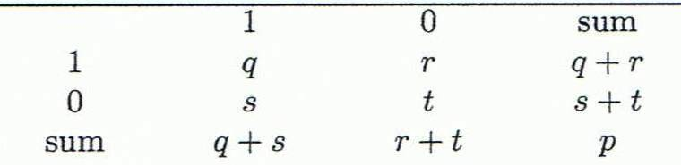
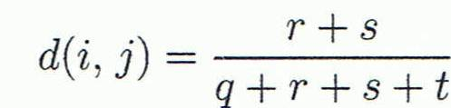
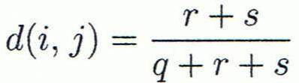

Proximity Measure for Binary Attributes
Object j
A contingency table for binary data
Distance measure for symmetric binary variables:
Distance measure for asymmetric binary variables:
Jaccard coefficient (similarity measure for asymmetric binary variables):
Object i
Note: Jaccard coefficient is the same as “coherence”:
Lecture 8-Measuring similarity and dissimilarity

Slide 13


Dissimilarity between Binary Variables
Example
  Gender is a symmetric attribute
  The remaining attributes are asymmetric binary
  Let the values Y and P be 1, and the value N 0
Lecture 8-Measuring similarity and dissimilarity

Slide 14

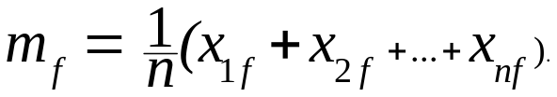
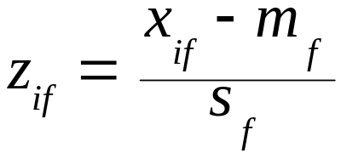
Standardizing Numeric Data
Z-score:
  X: raw score to be standardized, μ: mean of the population, σ: standard deviation
  the distance between the raw score and the population mean in units of the standard deviation
  negative when the raw score is below the mean, “+” when above
An alternative way: Calculate the mean absolute deviation
  where
  standardized measure (z-score):
Using mean absolute deviation is more robust than using standard deviation
Lecture 8-Measuring similarity and dissimilarity

Slide 15
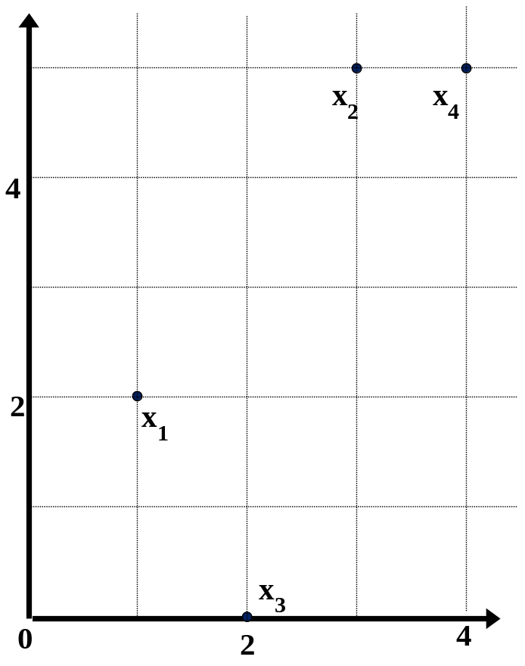
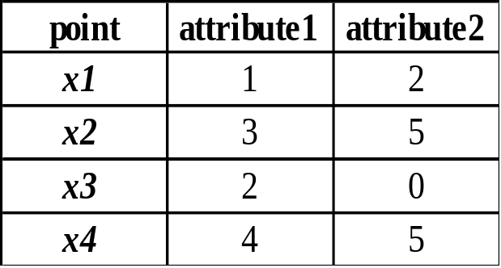
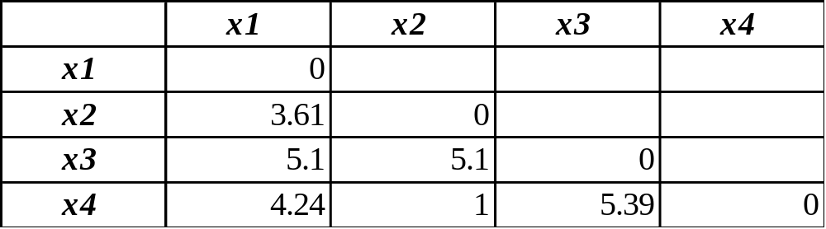
Example:
Data Matrix and Dissimilarity Matrix
Data Matrix
Dissimilarity Matrix
(with Euclidean Distance)
Lecture 8-Measuring similarity and dissimilarity

Slide 16
Distance on Numeric Data: Minkowski Distance
Minkowski distance: A popular distance measure
  where i = (x_{i1}, x_{i2}, …, x_{ip}) and j = (x_{j1}, x_{j2}, …, x_{jp}) are two p-dimensional data objects, and h is the order (the distance so defined is also called L-h norm)
Properties
  d(i, j) > 0 if i ≠ j, and d(i, i) = 0 (Positive definiteness)
  d(i, j) = d(j, i) (Symmetry)
  d(i, j) ≤ d(i, k) + d(k, j) (Triangle Inequality)
A distance that satisfies these properties is a metric
Lecture 8-Measuring similarity and dissimilarity

Slide 17


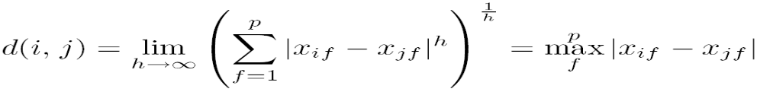
Special Cases of Minkowski Distance
h = 1: Manhattan (city block, L₁ norm) distance
  E.g., the Hamming distance: the number of bits that are different between two binary vectors
h = 2: (L₂ norm) Euclidean distance
h → ∞. “supremum” (L_{max} norm, L∞ norm) distance.
  This is the maximum difference between any component (attribute) of the vectors
Lecture 8-Measuring similarity and dissimilarity

Slide 18
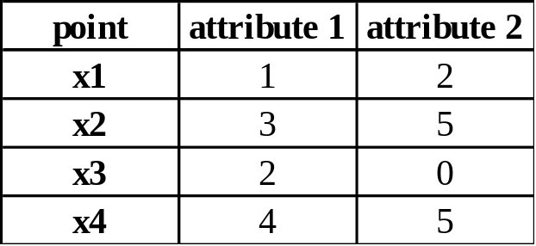
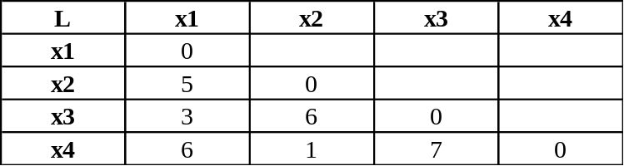
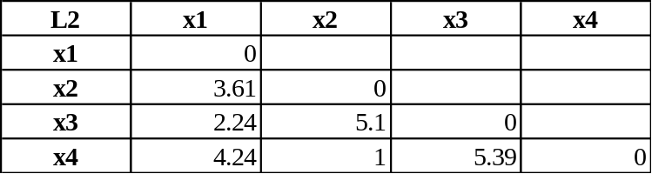
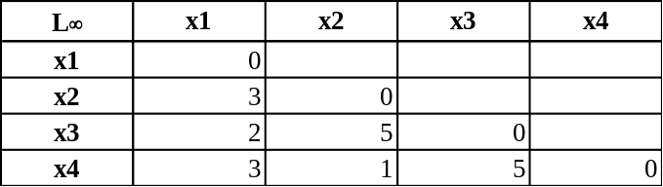
Example: Minkowski Distance
Dissimilarity Matrices
Manhattan (L₁)
Euclidean (L₂)
Supremum
Lecture 8-Measuring similarity and dissimilarity

Slide 19


Ordinal Variables
An ordinal variable can be discrete or continuous
Order is important, e.g., rank
Can be treated like interval-scaled
  replace x_{if} by their rank
  map the range of each variable onto [0, 1] by replacing i-th object in the f-th variable by
  compute the dissimilarity using methods for interval-scaled variables
Lecture 8-Measuring similarity and dissimilarity

Slide 20

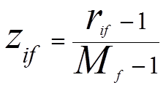
Attributes of Mixed Type
A database may contain all attribute types
  Nominal, symmetric binary, asymmetric binary, numeric, ordinal
One may use a weighted formula to combine their effects
  f is binary or nominal:
    d_{ij}^{(f)} = 0 if x_{if} = x_{jf} , or d_{ij}^{(f)} = 1 otherwise
  f is numeric: use the normalized distance
  f is ordinal
    Compute ranks r_{if} and
    Treat z_{if} as interval-scaled
Lecture 8-Measuring similarity and dissimilarity

Slide 21
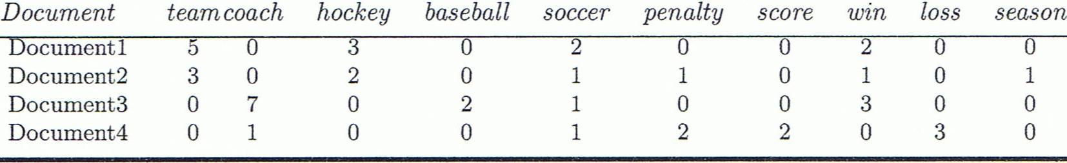
Cosine Similarity
A document can be represented by thousands of attributes, each recording the frequency of a particular word (such as keywords) or phrase in the document.
Other vector objects: gene features in micro-arrays, …
Applications: information retrieval, biologic taxonomy, gene feature mapping, ...
Cosine measure: If d₁ and d₂ are two vectors (e.g., term-frequency vectors), then
cos(d₁, d₂) = (d₁ • d₂) /||d₁|| ||d₂|| ,
  where • indicates vector dot product, ||d||: the length of vector d
Lecture 8-Measuring similarity and dissimilarity

Slide 22
Example: Cosine Similarity
cos(d₁, d₂) = (d₁ • d₂) /||d₁|| ||d₂|| ,
  where • indicates vector dot product, ||d|: the length of vector d
Ex: Find the similarity between documents 1 and 2.
  d₁ = (5, 0, 3, 0, 2, 0, 0, 2, 0, 0)
  d₂ = (3, 0, 2, 0, 1, 1, 0, 1, 0, 1)
  d₁•d₂ = 5*3+0*0+3*2+0*0+2*1+0*1+0*1+2*1+0*0+0*1 = 25
  ||d₁||= (5*5+0*0+3*3+0*0+2*2+0*0+0*0+2*2+0*0+0*0)^{0.5}=(42)^{0.5} = 6.481
  ||d₂||= (3*3+0*0+2*2+0*0+1*1+1*1+0*0+1*1+0*0+1*1)^{0.5}=(17)^{0.5} = 4.12
  cos(d₁, d₂ ) = 0.94
Lecture 8-Measuring similarity and dissimilarity

Slide 23
Lecture 9
Data Pre-processing

Slide 24
Data Quality: Why Preprocess the Data?
Measures for data quality: A multidimensional view
  Accuracy: correct or wrong, accurate or not
  Completeness: not recorded, unavailable, …
  Consistency: some modified but some not, dangling, …
  Timeliness: timely update?
  Believability: how trustable the data are correct?
  Interpretability: how easily the data can be understood?
Lecture 9-Data Pre_processing

Slide 25
Major Tasks in Data Preprocessing
Data cleaning
  Fill in missing values, smooth noisy data, identify or remove outliers, and resolve inconsistencies
Data integration
  Integration of multiple databases, data cubes, or files
Data reduction
  Dimensionality reduction
  Numerosity reduction
  Data compression
Data transformation and data discretization
  Normalization
  Concept hierarchy generation
Lecture 9-Pre_processing

Slide 26
Data Cleaning
Data in the Real World Is Dirty: Lots of potentially incorrect data, e.g., instrument faulty, human or computer error, transmission error
  incomplete: lacking attribute values, lacking certain attributes of interest, or containing only aggregate data
    e.g., Occupation=“ ” (missing data)
  noisy: containing noise, errors, or outliers
    e.g., Salary=“−10” (an error)
  inconsistent: containing discrepancies in codes or names, e.g.,
    Age=“42”, Birthday=“03/07/2010”
    Was rating “1, 2, 3”, now rating “A, B, C”
    discrepancy between duplicate records
  Intentional (e.g., disguised missing data)
    Jan. 1 as everyone’s birthday?
Lecture 9-Pre_processing

Slide 27
Incomplete (Missing) Data
Data is not always available
  E.g., many tuples have no recorded value for several attributes, such as customer income in sales data
Missing data may be due to
  equipment malfunction
  inconsistent with other recorded data and thus deleted
  data not entered due to misunderstanding
  certain data may not be considered important at the time of entry
  not register history or changes of the data
Missing data may need to be inferred
Lecture 9-Pre_processing

Slide 28
How to Handle Missing Data?
Ignore the tuple: usually done when class label is missing (when doing classification)—not effective when the % of missing values per attribute varies considerably
Fill in the missing value manually: tedious + infeasible?
Fill in it automatically with
  a global constant : e.g., “unknown”, a new class?!
  the attribute mean
  the attribute mean for all samples belonging to the same class: smarter
  the most probable value: inference-based such as Bayesian formula or decision tree
Lecture 9-Pre_processing

Slide 29
Noisy Data
Noise: random error or variance in a measured variable
Incorrect attribute values may be due to
  faulty data collection instruments
  data entry problems
  data transmission problems
  technology limitation
  inconsistency in naming convention
Other data problems which require data cleaning
  duplicate records
  incomplete data
  inconsistent data
Lecture 9-Pre_processing

Slide 30
How to Handle Noisy Data?
Binning
  first sort data and partition into (equal-frequency) bins
  then one can smooth by bin means, smooth by bin median, smooth by bin boundaries, etc.
Regression
  smooth by fitting the data into regression functions
Clustering
  detect and remove outliers
Combined computer and human inspection
  detect suspicious values and check by human (e.g., deal with possible outliers)
Lecture 9-Pre_processing

Slide 31
Data Cleaning as a Process
Data discrepancy detection
  Use metadata (e.g., domain, range, dependency, distribution)
  Check field overloading
  Check uniqueness rule, consecutive rule and null rule
  Use commercial tools for data discrepancy detection
    Data scrubbing: use simple domain knowledge (e.g., postal code, spell-check) to detect errors and make corrections. This tools rely on parsing and fuzzy matching techniques.
    Data auditing: by analyzing data to discover rules and relationship to detect violators (e.g., correlation and clustering to find outliers)
    We need to define and apply a series of transformations to correct them.
Data migration and integration
  Data migration tools: allow simplex transformations to be specified
  ETL (Extraction/Transformation/Loading) tools: allow users to specify transformations through a graphical user interface
Lecture 9-Pre_processing

Slide 32
Data Integration
Data integration:
  Combines data from multiple sources into a coherent store
Schema integration: e.g., A.cust-id ≡ B.cust-#
  Integrate metadata from different sources
Entity identification problem:
  Identify real world entities from multiple data sources, e.g., Bill Clinton = William Clinton
Detecting and resolving data value conflicts
  For the same real world entity, attribute values from different sources are different
  Possible reasons: different representations, different scales, e.g., metric vs. British units
Lecture 9-Pre_processing

Slide 33
Handling Redundancy in Data Integration
Redundant data occur often when integration of multiple databases
  Object identification: The same attribute or object may have different names in different databases
  Derivable data: One attribute may be a “derived” attribute in another table, e.g., annual revenue
Redundant attributes may be able to be detected by correlation analysis and covariance analysis
Careful integration of the data from multiple sources may help reduce/avoid redundancies and inconsistencies and improve mining speed and quality
Lecture 9-Pre_processing

Slide 34
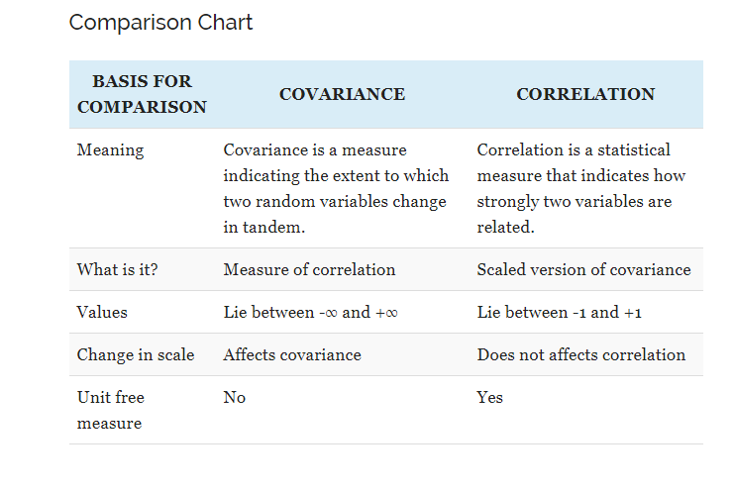
Covariance and Correlation
Covariance and Correlation are two mathematical concepts which are quite commonly used in business statistics.
Both of these two determine the relationship and measures the dependency between two random variables.
Despite, some similarities between these two mathematical terms, they are different from each other.
Correlation is when the change in one item may result in the change in another item
Correlation is considered as the best tool for for measuring and expressing the quantitative relationship between two variables in formula
. On the other hand, covariance is when two items vary together.
Lecture 9-Pre_processing

Slide 35

Correlation Analysis (Nominal Data)
Χ² (chi-square) test
The larger the Χ² value, the more likely the variables are related
The cells that contribute the most to the Χ² value are those whose actual count is very different from the expected count
Correlation does not imply causality
  # of hospitals and # of car-theft in a city are correlated
  Both are causally linked to the third variable: population
Lecture 9-Pre_processing

Slide 36
Chi-Square Calculation: An Example
 | Play chess | Not play chess | Sum (row)
Like science fiction | 250(90) | 200(360) | 450
Not like science fiction | 50(210) | 1000(840) | 1050
Sum(col.) | 300 | 1200 | 1500
Χ² (chi-square) calculation (numbers in parenthesis are expected counts calculated based on the data distribution in the two categories)
It shows that like_science_fiction and play_chess are correlated in the group
Lecture 9-Pre_processing

Slide 37



Correlation Analysis (Numeric Data)
Correlation coefficient (also called Pearson’s product moment coefficient)
  where n is the number of tuples, and are the respective means of A and B, σ_{A} and σ_{B} are the respective standard deviation of A and B, and Σ(a_{i}b_{i}) is the sum of the AB cross-product.
If r_{A,B} > 0, A and B are positively correlated (A’s values increase as B’s). The higher, the stronger correlation.
r_{A,B} = 0: independent; r_{AB} < 0: negatively correlated
Lecture 9-Pre_processing

Slide 38

Visually Evaluating Correlation
Scatter plots showing the similarity from –1 to 1.
Lecture 9-Pre_processing

Slide 39



Correlation (viewed as linear relationship)
Correlation measures the linear relationship between objects
To compute correlation, we standardize data objects, A and B, and then take their dot product
Lecture 9-Pre_processing

Slide 40


Covariance (Numeric Data)
Covariance is similar to correlation
  where n is the number of tuples, and are the respective mean or expected values of A and B, σ_{A} and σ_{B} are the respective standard deviation of A and B.
Positive covariance: If Cov_{A,B} > 0, then A and B both tend to be larger than their expected values.
Negative covariance: If Cov_{A,B} < 0 then if A is larger than its expected value, B is likely to be smaller than its expected value.
Independence: Cov_{A,B} = 0 but the converse is not true:
  Some pairs of random variables may have a covariance of 0 but are not independent. Only under some additional assumptions (e.g., the data follow multivariate normal distributions) does a covariance of 0 imply independence
Correlation coefficient:
Lecture 9-Pre_processing

Slide 41

Co-Variance: An Example
It can be simplified in computation as
Suppose two stocks A and B have the following values in one week: (2, 5), (3, 8), (5, 10), (4, 11), (6, 14).
Question: If the stocks are affected by the same industry trends, will their prices rise or fall together?
  E(A) = (2 + 3 + 5 + 4 + 6)/ 5 = 20/5 = 4
  E(B) = (5 + 8 + 10 + 11 + 14) /5 = 48/5 = 9.6
  Cov(A,B) = (2×5+3×8+5×10+4×11+6×14)/5 − 4 × 9.6 = 4
Thus, A and B rise together since Cov(A, B) > 0.
Lecture 9-Pre_processing

Slide 42
Data Reduction Strategies
Data reduction: Obtain a reduced representation of the data set that is much smaller in volume but yet produces the same (or almost the same) analytical results
Why data reduction? — A database/data warehouse may store terabytes of data. Complex data analysis may take a very long time to run on the complete data set.
Data reduction strategies
  -Dimensionality reduction, e.g., remove unimportant attributes
    Wavelet transforms(uses filters, Remove outliers, performed clustering)
    Principal Components Analysis (PCA)-(PCA is useful when there is data on a large number of variables, and (possibly) there is some redundancy in those variables.
    In this case, redundancy means that some of the variables are correlated with one another.
    And because of this redundancy, PCA can be used to reduce the observed variables into a smaller number of principal components that will account for most of the variance in the observed variables.)
Lecture 9-Pre_processing

Slide 43
Data Reduction Strategies
    Feature subset selection, feature creation
  Numerosity reduction (some simply call it: Data Reduction) Replace the original data volume into smaller form of data representation
  This technique can be parametric
    Regression and Log-Linear Models
    Non Parametric
    Histograms, clustering, sampling
    Data cube aggregation
  Data compression
Lecture 9-Pre_processing

Slide 44
Attribute Subset Selection
Another way to reduce dimensionality of data
Redundant attributes
  Duplicate much or all of the information contained in one or more other attributes
  E.g., purchase price of a product and the amount of sales tax paid
Irrelevant attributes
  Contain no information that is useful for the data mining task at hand
  E.g., students' ID is often irrelevant to the task of predicting students' GPA
Lecture 9-Pre_processing

Slide 45
Heuristic Search in Attribute Selection
There are 2^{d} possible attribute combinations of d attributes
Typical heuristic attribute subset selection methods:
Stepwise forward selection:
Starts with empty set, best of the original attributes is determined and added to the reduced set. At each subsequent iteration best remaining original attributes are added to the set
2. Stepwise backward elimination
Starts with the full set of attributes. At each step , it removes the worst attribute .
3. Combination of forward selection and backward elimination
Each step , it selects the best attribute and removes the worst from among the remaining attributes
4. Decision tree induction: ID3, C4.5 and CART. Attributes that do not appear in the tree is considered as irrelevant. Attributes appearing in the tree form the reduced subset of attributes.
Lecture 9-Pre_processing

Slide 46
Attribute Creation (Feature Generation)
Create new attributes (features) that can capture the important information in a data set more effectively than the original ones
Three general methodologies
  Attribute extraction
    Domain-specific
  Mapping data to new space (see: data reduction)
    E.g., Fourier transformation, wavelet transformation, manifold approaches (not covered)
  Attribute construction
    Combining features (see: discriminative frequent patterns in Chapter 7)
    Data discretization
Lecture 9-Pre_processing

Slide 47
Data Reduction 2: Numerosity Reduction
Reduce data volume by choosing alternative, smaller forms of data representation
Parametric methods (e.g., regression)
  Assume the data fits some model, estimate model parameters, store only the parameters, and discard the data (except possible outliers)
  Ex.: Log-linear models—obtain value at a point in m-D space as the product on appropriate marginal subspaces
Non-parametric methods
  Do not assume models
  Major families: histograms, clustering, sampling, …
Lecture 9-Pre_processing

Slide 48
Parametric Data Reduction: Regression and Log-Linear Models
Linear regression(one independent variable and one dependent variable)
  Data modeled to fit a straight line
  Often uses the least-square method to fit the line
Multiple regression(Multiple Independent variable one dependent variable)
  Allows a response variable Y to be modeled as a linear function of multidimensional feature vector
Log-linear model
  Approximates discrete multidimensional probability distributions
  Logistic regression is used to find the probability of event=Success and event=Failure. We should use logistic regression when the dependent variable is binary (0/ 1, True/ False, Yes/ No) in nature.
Lecture 9-Pre_processing

Slide 49
Regression Analysis
Regression analysis: A collective name for techniques for the modeling and analysis of numerical data consisting of values of a dependent variable (also called response variable or measurement) and of one or more independent variables (aka. explanatory variables or predictors)
The parameters are estimated so as to give a "best fit" of the data
Most commonly the best fit is evaluated by using the least squares method, but other criteria have also been used
Y1
Y1’
y = x + 1
X1
x
Used for prediction (including forecasting of time-series data), inference, hypothesis testing, and modeling of causal relationships
Lecture 9-Pre_processing

Slide 50
Regress Analysis and Log-Linear Models
Linear regression: Y = w X + b
  Two regression coefficients, w and b, specify the line and are to be estimated by using the data at hand
  Using the least squares criterion to the known values of Y₁, Y₂, …, X₁, X₂, ….
Multiple regression: Y = b₀ + b₁ X₁ + b₂ X₂
  Many nonlinear functions can be transformed into the above
Log-linear models:
  Approximate discrete multidimensional probability distributions
  Estimate the probability of each point (tuple) in a multi-dimensional space for a set of discretized attributes, based on a smaller subset of dimensional combinations
  Useful for dimensionality reduction and data smoothing
Lecture 9-Pre_processing

Slide 51
Lecture 10
  Histograms, Clustering and Sampling, Data Transformation

Slide 52
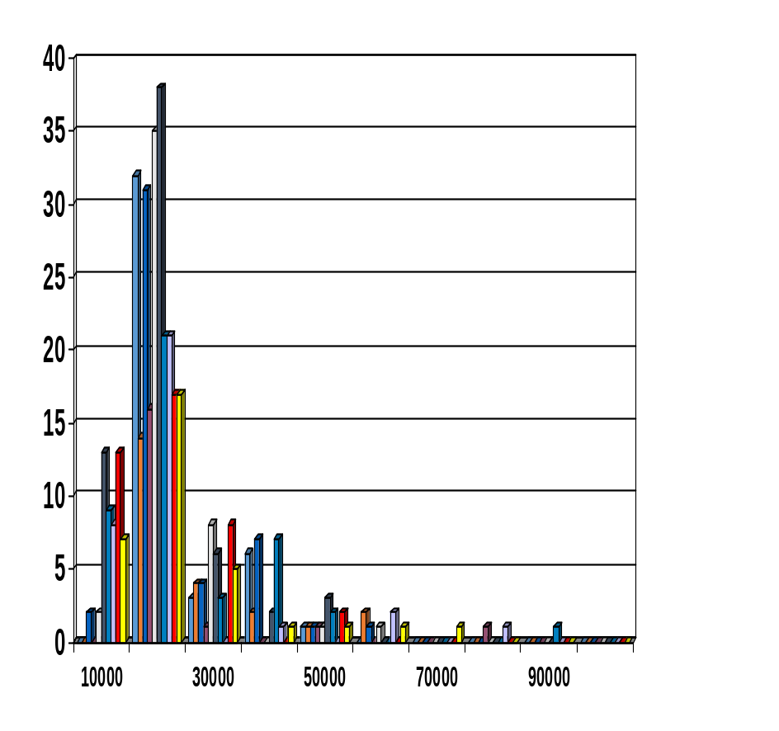
Non Parametric reduction: Histogram Analysis
Divide data into buckets and store average (sum) for each bucket
Partitioning rules:
  Equal-width: equal bucket range
  Equal-frequency (or equal-depth)
Lecture 10 - Histograms, Clustering and Sampling, Data Transformation

Slide 53
Clustering
Partition data set into clusters based on similarity, and store cluster representation (e.g., centroid and diameter) only
Can be very effective if data is clustered but not if data is “smeared”
Can have hierarchical clustering and be stored in multi-dimensional index tree structures
There are many choices of clustering definitions and clustering algorithms
Cluster analysis will be studied in depth in Chapter 10
Lecture 10 - Histograms, Clustering and Sampling, Data Transformation

Slide 54
Sampling
Sampling: obtaining a small sample s to represent the whole data set N
Allow a mining algorithm to run in complexity that is potentially sub-linear to the size of the data
Key principle: Choose a representative subset of the data
  Simple random sampling may have very poor performance in the presence of skew
  Develop adaptive sampling methods, e.g., stratified sampling:
Note: Sampling may not reduce database I/Os (page at a time)
Lecture 10 - Histograms, Clustering and Sampling, Data Transformation

Slide 55
Types of Sampling
Simple random sampling
  There is an equal probability of selecting any particular item
Sampling without replacement
  Once an object is selected, it is removed from the population
Sampling with replacement
  A selected object is not removed from the population
Stratified sampling:
  Partition the data set, and draw samples from each partition (proportionally, i.e., approximately the same percentage of the data)
  Used in conjunction with skewed data
Lecture 10 - Histograms, Clustering and Sampling, Data Transformation

Slide 56
Sampling: With or without Replacement
SRSWOR
(simple random
sample without
replacement)
SRSWR
Raw Data
Lecture 10 - Histograms, Clustering and Sampling, Data Transformation

Slide 57
Sampling: Cluster or Stratified Sampling
Raw Data
Cluster/Stratified Sample
Lecture 10 - Histograms, Clustering and Sampling, Data Transformation

Slide 58
Data Cube Aggregation
The lowest level of a data cube (base cuboid)
  The aggregated data for an individual entity of interest
  E.g., a customer in a phone calling data warehouse
Multiple levels of aggregation in data cubes
  Further reduce the size of data to deal with
Reference appropriate levels
  Use the smallest representation which is enough to solve the task
Queries regarding aggregated information should be answered using data cube, when possible
Lecture 10 - Histograms, Clustering and Sampling, Data Transformation

Slide 59
Data Reduction 3: Data Compression
String compression
  There are extensive theories and well-tuned algorithms
  Typically lossless, but only limited manipulation is possible without expansion
Audio/video compression
  Typically lossy compression, with progressive refinement
  Sometimes small fragments of signal can be reconstructed without reconstructing the whole
Time sequence is not audio
  Typically short and vary slowly with time
Dimensionality and numerosity reduction may also be considered as forms of data compression
Lecture 10 - Histograms, Clustering and Sampling, Data Transformation

Slide 60
Data Compression
Original Data
Compressed
Data
lossless
Original Data
Approximated
lossy
Lecture 10 - Histograms, Clustering and Sampling, Data Transformation

Slide 61
Data Transformation
A function that maps the entire set of values of a given attribute to a new set of replacement values such that each old value can be identified with one of the new values
Methods
  Smoothing: Remove noise from data Techniques include binning , regression and clustering
  Attribute/feature construction
    New attributes constructed from the given ones
  Aggregation: Summarization, data cube construction(daily sales -> monthly, annual amount)
  Normalization: Scaled to fall within a smaller, specified range
    min-max normalization
    z-score normalization
    normalization by decimal scaling
  Discretization: Raw values of a numeric attribute are replaced by interval labels(age->0-10,11-20) or conceptual labels
  Concept hierarchy generation for nominal data
Lecture 10 - Histograms, Clustering and Sampling, Data Transformation

Slide 62
Lecture 11
  Normalization, Binning, Histogram analysis and concept hierarchy generation

Slide 63





Normalization
Min-max normalization: to [new_min_{A}, new_max_{A}]
  Ex. Let income range $12,000 to $98,000 normalized to [0.0, 1.0]. Then $73,000 is mapped to
Z-score normalization (μ: mean, σ: standard deviation):
  Ex. Let μ = 54,000, σ = 16,000. Then
Normalization by decimal scaling
Where j is the smallest integer such that Max(|ν’|) < 1
Lecture 11-Normalization, Binning, Histogram analysis and concept hierarchy generation

Slide 64
Discretization
Data discretization converts a large number of data values into smaller once, so that data evaluation and data management becomes very easy.
Three types of attributes
  Nominal—values from an unordered set, e.g., color, profession
  Ordinal—values from an ordered set, e.g., military or academic rank
  Numeric—real numbers, e.g., integer or real numbers
Discretization: Divide the range of a continuous attribute into intervals
  Interval labels can then be used to replace actual data values
  Reduce data size by discretization
  Supervised vs. unsupervised
  Split (top-down) vs. merge (bottom-up)
  Discretization can be performed recursively on an attribute
  Prepare for further analysis, e.g., classification
Lecture 11-Normalization, Binning, Histogram analysis and concept hierarchy generation

Slide 65
Data Discretization Methods
Typical methods: All the methods can be applied recursively
  Binning
    Top-down split, unsupervised
  Histogram analysis
    Top-down split, unsupervised
  Clustering analysis (unsupervised, top-down split or bottom-up merge)
  Decision-tree analysis (supervised, top-down split)
  Correlation (e.g., χ²) analysis (unsupervised, bottom-up merge)
Lecture 11-Normalization, Binning, Histogram analysis and concept hierarchy generation

Slide 66
Simple Discretization: Binning
Equal-width (distance) partitioning
  Divides the range into N intervals of equal size: uniform grid
  if A and B are the lowest and highest values of the attribute, the width of intervals will be: W = (B –A)/N.
  The most straightforward, but outliers may dominate presentation
  Skewed data is not handled well
Equal-depth (frequency) partitioning
  Divides the range into N intervals, each containing approximately same number of samples
  Good data scaling
  Managing categorical attributes can be tricky
Lecture 11-Normalization, Binning, Histogram analysis and concept hierarchy generation

Slide 67
Binning Methods for Data Smoothing
Sorted data for price (in dollars): 4, 8, 9, 15, 21, 21, 24, 25, 26, 28, 29, 34
* Partition into equal-frequency (equi-depth) bins:
- Bin 1: 4, 8, 9, 15
- Bin 2: 21, 21, 24, 25
- Bin 3: 26, 28, 29, 34
* Smoothing by bin means:
- Bin 1: 9, 9, 9, 9
- Bin 2: 23, 23, 23, 23
- Bin 3: 29, 29, 29, 29
Smoothing by bin boundaries(Minimum and maximum values are identified and replace the values with closer value of boundary)
- Bin 1: 4, 4, 4, 15
- Bin 2: 21, 21, 25, 25
- Bin 3: 26, 26, 26, 34
Lecture 11-Normalization, Binning, Histogram analysis and concept hierarchy generation

Slide 68




Discretization Without Using Class Labels
(Binning vs. Clustering)
Data
Equal interval width (binning)
Equal frequency (binning)
K-means clustering leads to better results
Lecture 11-Normalization, Binning, Histogram analysis and concept hierarchy generation

Slide 69
Discretization by Classification & Correlation Analysis
Classification (e.g., decision tree analysis)
  Supervised: Given class labels, e.g., cancerous vs. benign
  Using entropy to determine split point (discretization point)
  Top-down, recursive split
  Details to be covered in Chapter 7
Correlation analysis (e.g., Chi-merge: χ²-based discretization)
  Supervised: use class information
  Bottom-up merge: find the best neighboring intervals (those having similar distributions of classes, i.e., low χ² values) to merge
  Merge performed recursively, until a predefined stopping condition
Lecture 11-Normalization, Binning, Histogram analysis and concept hierarchy generation

Slide 70
Concept Hierarchy Generation
Concept hierarchy organizes concepts (i.e., attribute values) hierarchically and is usually associated with each dimension in a data warehouse
Concept hierarchies facilitate drilling and rolling in data warehouses to view data in multiple granularity
Concept hierarchy formation: Recursively reduce the data by collecting and replacing low level concepts (such as numeric values for age) by higher level concepts (such as youth, adult, or senior)
Concept hierarchies can be explicitly specified by domain experts and/or data warehouse designers
Concept hierarchy can be automatically formed for both numeric and nominal data. For numeric data, use discretization methods shown.
Lecture 11-Normalization, Binning, Histogram analysis and concept hierarchy generation

Slide 71
Concept Hierarchy Generation for Nominal Data
Specification of a partial/total ordering of attributes explicitly at the schema level by users or experts
  street < city < state < country
Specification of a hierarchy for a set of values by explicit data grouping
  {Urbana, Champaign, Chicago} < Illinois
Specification of only a partial set of attributes
  E.g., only street < city, not others
Automatic generation of hierarchies (or attribute levels) by the analysis of the number of distinct values
  E.g., for a set of attributes: {street, city, state, country}
Lecture 11-Normalization, Binning, Histogram analysis and concept hierarchy generation

Slide 72
Automatic Concept Hierarchy Generation
Some hierarchies can be automatically generated based on the analysis of the number of distinct values per attribute in the data set
  The attribute with the most distinct values is placed at the lowest level of the hierarchy
  Exceptions, e.g., weekday, month, quarter, year
country
15 distinct values
province_or_ state
365 distinct values
city
3567 distinct values
street
674,339 distinct values
Lecture 11-Normalization, Binning, Histogram analysis and concept hierarchy generation

Slide 73
Thank You

